Slide 1
Subprime crisis influence on house ownership rate by races
By James Chiu
Jiqi Pan
Wenyi Cai

Slide 2
1. Introduction
Back ground information: subprime crisis in 2007 to 2009.
Incentive of the paper: to study the subprime crisis’s influence to different races.
Proportion of Subprime Home Loans by Race (2006)
African American families (Black) | Hispanic families (Latino) | white non-Hispanic families (White)
52.44% | 40.66% | 22.20%
Source: Center for Responsible Lending analysis of 2006 Home Mortgage Disclosure Act (HMDA) data reported by the Federal Financial Institutions Examination Council

Slide 3
2.Literature review
Race and home Ownership,1900-1990
By William J. Collins and Robert A. Margo (NBER working paper)
Mortgage Pricing Differentials Across Hispanic, Black, and White Households: Evidence from the American Housing Survey (February 2006) (HUD USER paper)

Slide 4
Race and home ownership,1900-1990
The paper use home ownership rate data of black and white from 1900 to 1990.
The paper use linear probability model to estimate the variables’ influence to the home ownership rate. The variables including race, gender, age, geography area, and whether own a land.
The study further do decomposition study to explain the black and white home ownership gap, in some period the change of the gap is result from the political reasons.
This paper is our project’s example, but the timeline we use is different from the paper

Slide 5
Mortgage Pricing Differentials Across Hispanic, Black, and White Households: Evidence from the American Housing Survey (February 2006)
Published by Office of Policy Development and Research (PD&R) of HUD center
Use metropolitan area samples of the American Housing Survey (AHS) for 1998, 2002, and 2004 data
focus to examine that the differences in the interest rates obtained by homeowners of different races and income levels can be explained by differences in characteristics of the borrowers, the property, and the loan itself.

Slide 6
3.Data
Data source: Kauffman index dataset 2007 and 2008 The Kauffman Index measures the monthly rate of business creation at the individual owner level.
Data size: 678703 observations in each year’s data set.

Slide 7
3. Data
California is the third biggest state in the United State, and has a large number of minority population. Our study only include the observations who residents in California.

Slide 8
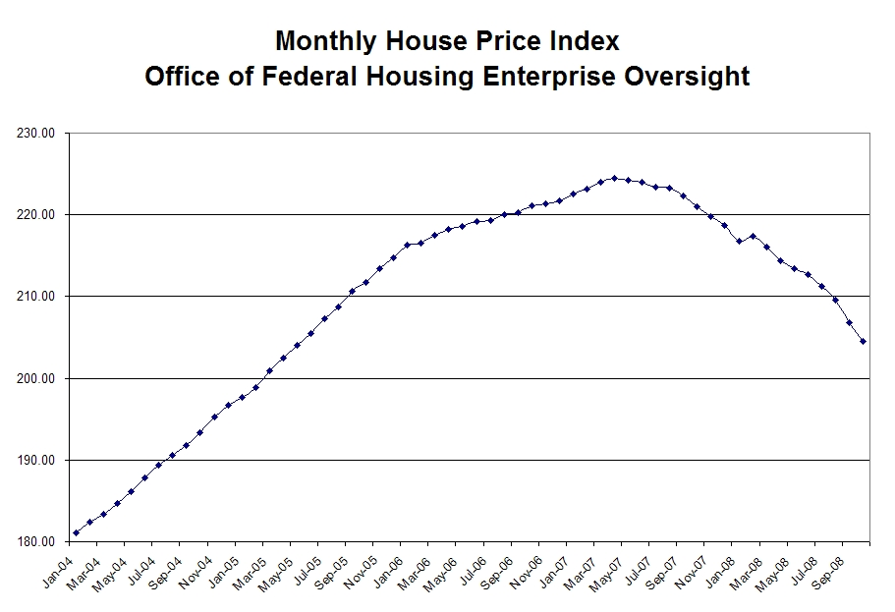
4.Data dividing (housing price)
The house price line from Jan2004 to Sep2008.
the housing price reached to its highest point in the May 2007 and it started fast dropping in September 2007, We select May 2007 to divide the pre-subprime period and post-subprime period.

Slide 9
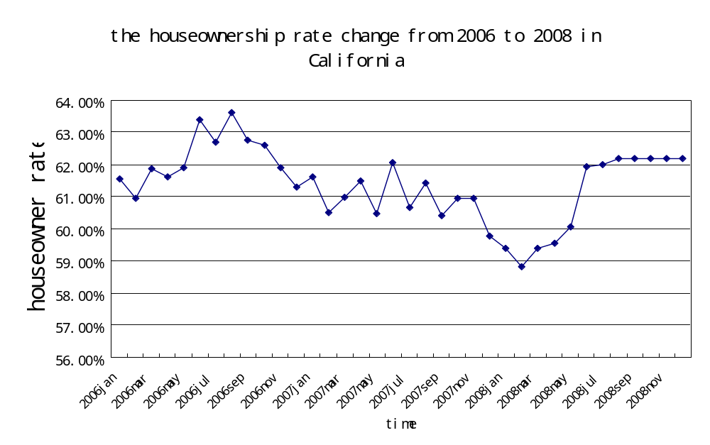
4.Data dividing (house owner rate)
There is a 7 months lag for the house ownership rate to react to the housing price fall.

Slide 10
5.Variables
Dependent variable:
Homeown=1 if own a house
Independent Variables:
Homeown
Age
Gender
Male=1 Female=0
Martial status
Married=1 if currently married

Slide 11
Race
Modified from original Variables Race and Spneth
White
=1 if White ethnic
Black
=1 if Black Ethnic
Asian
=1 if Asian Ethnic
Latino
=1 if Spanish ethnic
Education
Modified from original Variables grdatn
NoDiploma
=1 if education lower than high school
HSgrad
=1 if High school grad
SomeCollaa
=1 if some college without degree
BA
=1 if college grad
Grad
=1 if graduate school student

Slide 12
Income
Modified from original variable faminc
Incomelessthan30000
=1 if income less than 30000
Incomelessthan60000
=1 if income less than 60000 but higher than 30000
Incomelessthan100000
=1 if income less than 100000 but higher than 60000
Income100000higher
=1 if income higher than 100000
Employment status
Modified from original variable Mrl_t1
employed
=1 if employed in the monthly data
unemployed
=1 if unemployed in the monthly data
NILF
=1 if disable retire or others

Slide 13
Class of Worker
Modified from original variable Class_t1
GovWorker
=1 if employ by government
Private
=1 if employ by private organization
Selfemploy
=1 if self employed
Central City Status
Modified from original variable Central City Statue
Centralcity
=1 if live in the central city area
BalanceMSA
=1 if live in suburbs
Nonmetropolitan
=1 if live far from metropolitan area
Noidentified
=1 if observation not identified

Slide 14
Mean of variables in the pre-subprime period(Jan2007 to Jul2007)
Variable | N | Mean | S.D.
homeown | 64950 | 0.61813 | 0.485
age | 64950 | 40.8525 | 12.11
male | 64950 | 0.48217 | 0.499
Married | 64950 | 0.58823 | 0.492
White | 64950 | 0.78965 | 0.408
Black | 64950 | 0.05421 | 0.226
Asian | 64950 | 0.12110 | 0.326
Latino | 64950 | 0.33639 | 0.472
NoDiploma | 64950 | 0.17248 | 0.378
HSGrad | 64950 | 0.22809 | 0.419
SomeCollAA | 64950 | 0.30494 | 0.460
BA | 64950 | 0.20146 | 0.401
Grad | 64950 | 0.09301 | 0.246
Incomelessthan30000 | 64950 | 0.19199 | 0.393
Variable | N | Mean | S.D.
Incomelessthan60000 | 64950 | 0.2330 | 0.4222
Incomelessthan100000 | 64950 | 0.4249 | 0.4942
Income100000higher | 64950 | 0 | 0
Employed | 64950 | 0.7365 | 0.4396
Unemployed | 64950 | 0.0341 | 0.1801
NILF | 64950 | 0.2292 | 0.4197
GovWorker | 64950 | 0.10799 | 0.3110
Private | 64950 | 0.5553 | 0.4968
SelfEmploy | 64950 | 0.1051 | 0.3068
centralcity | 64950 | 0.16694 | 0.3442
BalanceMSA | 64950 | 0.15496 | 0.3335
Nonmetropolitan | 64950 | 0.00666 | 0.0738
notidentified | 64950 | 0.48217 | 0.1571

Slide 15
Mean of variables in the post-subprime period
(Jan2007 to Jul2007)
Variable | N | Mean | S.D.
homeown | 60782 | 0.60402 | 0.48906
age | 60782 | 41.0916 | 12.2810
male | 60782 | 0.48494 | 0.49977
Married | 60782 | 0.58296 | 0.49307
White | 60782 | 0.78380 | 0.41165
Black | 60782 | 0.05888 | 0.23540
Asian | 60782 | 0.12388 | 0.32945
Latino | 60782 | 0.34251 | 0.47455
NoDiploma | 60782 | 0.16830 | 0.37414
HSGrad | 60782 | 0.22911 | 0.42026
SomeCollAA | 60782 | 0.29362 | 0.45542
BA | 60782 | 0.21037 | 0.40757
Grad | 60782 | 0.09858 | 0.25606
Incomelessthan30000 | 60782 | 0.17457 | 0.3796
Variable | N | Mean | S.D.
Incomelessthan60000 | 60782 | 0.22403 | 0.41694
Incomelessthan100000 | 60782 | 0.42988 | 0.49506
Income100000higher | 60782 | 0 | 0
Employed | 60782 | 0.73771 | 0.43987
Unemployed | 60782 | 0.04014 | 0.19629
NILF | 60782 | 0.22213 | 0.41568
GovWorker | 60782 | 0.11029 | 0.31326
Private | 60782 | 0.56465 | 0.49580
SelfEmploy | 60782 | 0.09999 | 0.29999
Nopay | 60782 | 0.00108 | 0.03293
centralcity | 60782 | 0.46146 | 0.49851
BalanceMSA | 60782 | 0.43417 | 0.49565
Nonmetropolitan | 60782 | 0.01742 | 0.13084
notidentified | 60782 | 0.08693 | 0.28174

Slide 16
H_{t} =β₀+β₁X_{t} +β₂ I_{t} +β₃G_{t} + ε_{t}
Logit Model
H: homeownership rate (Binary dependent variable)
X: Ethnicity dummy variables
I: a vector of individual characteristics
G: Geographical dummies
β: coefficient vectors
ε: error term
t: periods (pre May 2007 and post May 2007)

Slide 17
Ethnicity Categories
Whites*
Blacks
Asians
Latinos
* indicates that this group is the reference group in the regression

Slide 18
Individual characteristics
age
working hours
family income
education
employment status
class of worker
Gender
marital status
Employed*
Unemployed
Not in labor force
0-30,000 *
30,000-60,000
60,000-100,000
Government employee*
Private employee
Self-employed
No high school Diploma*
High school graduate
Some college
BA
Graduate (MA&Doctorate)

Slide 19
Geographic Location
Central City*
Metropolitan statistical area, but not in a central city
Non-metropolitan area
Not identified

Slide 20
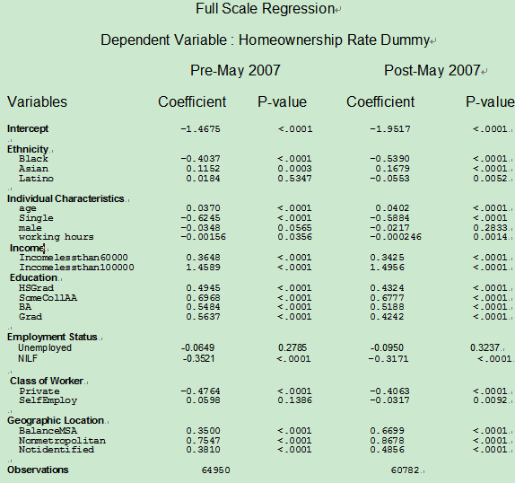

Slide 21
Education’s Effect on homeownership rate by races
 | white | black | Asian | Latino
Hsgrad | 0.4912 | 0.9782 | 0.6242 | 0.4298
somecollege | 0.7339 | 1.0416 | 0.9129 | 0.6225
BA | 0.5168 | 1.2567 | 0.7795 | 0.6078
Grad | 0.6230 | 1.3741 | 0.6364 | 0.766
Hsgrad | 0.5142 | 0.5023 | 0.6447 | 0.3268
somecollege | 0.7939 | 0.5559 | 1.041 | 0.6226
BA | 0.5280 | 0.7545 | 0.8114 | 0.2972
Grad | 0.5273 | 1.0345 | 0.4119 | 0.64
Pre
Post

Slide 22
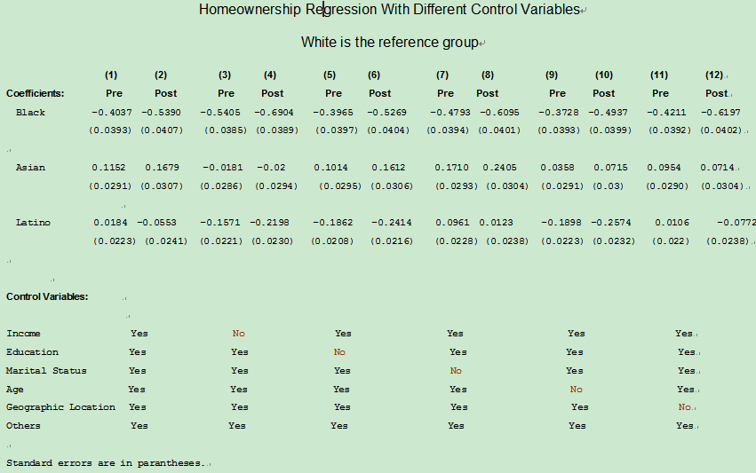

Slide 23
The Change of Homeownership Rate During the Crisis
 | pre | post | change
race | mean | mean
White | 0.6188 | 0.6093 | -1.53%
Black | 0.5058 | 0.45 | -11%
Asian | 0.6657 | 0.6518 | -2%
Latino | 0.5186 | 0.501 | -3%

Slide 24
Preliminary Conclusion
All the four ethnic groups deteriorated during the crisis. Blacks got much worse than the other three groups. Asians still have the biggest homeownership rate. Whites are the most stable one.
Income, education, age, marital status and MSA status are more correlated with the racial difference in the change of homeownership rate than other factors.

Slide 25

Decomposition Model
An Extension of the Blinder - Oaxaca Decomposition Technique to Logit and Probit Models - Robert W. Fairlie (Jan 2006)
The Blinder-Oaxaca decomposition technique is widely used to identify and quantify the
separate contributions of group differences in measurable characteristics, such as education,
experience, marital status, and geographical differences to racial and gender gaps in
outcomes. The technique cannot be used directly, however, if the outcome is binary and the
coefficients are from a logit or probit model.
Linear Decomposition
Non-Linear Decomposition for Logit Model

Slide 26
Variables
X – includes the variables:
  (age, male, single, hours, faminc, educ, class, mlr and msa)
  faminc: incomelessthan60000 incomelessthan100000
  educ: hsgrad somecollaa ba grad
  class: private selfemploy
  mlr (Monthly Labor Force): unemployed nilf
  msa (Metropolitan Status): balancemsa nonmetropolitan notidentified
β – Coefficient Estimates
N – Number of Observations

Slide 27
Blacks to White Decomposition
 | Pre | Post
Number of Obs | 54809 | 51220
N of obs G=0 | 3521 | 3579
N of obs G=1 | 51288 | 47641 | %Δ
Pr(Y!=0|G=0) | 0.50582221 | 0.45012573 | 0.110
Pr(Y!=0|G=1) | 0.61876072 | 0.60930711 | 0.015
Difference | -0.11293851 | -0.15918138 | -0.409
Total Explained | -0.03658716 | -0.0598288 | -0.635

Slide 28
Blacks to White Decomposition
homeown (pre) | Coefficients | % of Diff Explained | Std. Err. | z | P>|z| | [95% Conf. | Interval]
age | 0.0057008 | -0.0504770 | 0.0007486 | 7.62 | 0 | 0.0042335 | 0.007168
male | 0.0001327 | -0.0011750 | 0.0008714 | 0.15 | 0.879 | -0.0015752 | 0.001841
single | -0.0404168 | 0.3578655 | 0.0034413 | -11.7 | 0 | -0.0471616 | -0.033672
hours | 0.0095268 | -0.0843539 | 0.0026913 | 3.54 | 0 | 0.0042519 | 0.014802
faminc | -0.0331215 | 0.2932702 | 0.0021863 | -15.2 | 0 | -0.0374065 | -0.028837
educ | 0.0230958 | -0.2044989 | 0.0042390 | 5.45 | 0 | 0.0147876 | 0.031404
class | 0.0053401 | -0.0472833 | 0.0024251 | 2.2 | 0.028 | 0.000587 | 0.010093
mlr | -0.0120331 | 0.1065456 | 0.0026453 | -4.55 | 0 | -0.0172178 | -0.006848
msa | 0.0058944 | -0.0521912 | 0.0024152 | 2.44 | 0.015 | 0.0011606 | 0.010628
Total Explained | -0.0365872 | 0.3239565
homeown (post) | Coefficients | % of Diff Explained | Std. Err. | z | P>|z| | [95% Conf. | Interval]
age | 0.0014526 | -0.009125439 | 0.000531 | 2.74 | 0.006 | 0.0004121 | 0.002493
male | 0.0006347 | -0.003987275 | 0.000829 | 0.77 | 0.444 | -0.0009891 | 0.002259
single | -0.0336737 | 0.211542958 | 0.003843 | -8.76 | 0 | -0.0412053 | -0.026142
hours | 0.001681 | -0.01056028 | 0.001452 | 1.16 | 0.247 | -0.0011641 | 0.004526
faminc | -0.0375086 | 0.235634344 | 0.002588 | -14.5 | 0 | -0.0425814 | -0.032436
educ | 0.006731 | -0.042285096 | 0.003448 | 1.95 | 0.051 | -0.0000268 | 0.013489
class | 0.0038626 | -0.024265401 | 0.002493 | 1.55 | 0.121 | -0.0010239 | 0.008749
mlr | -0.0042508 | 0.026704128 | 0.001705 | -2.49 | 0.013 | -0.0075929 | -0.000909
msa | 0.0013848 | -0.00869951 | 0.003606 | 0.38 | 0.701 | -0.0056835 | 0.008453
Total Explained | -0.0598288 | 0.375853005

Slide 29
Asians to White Decomposition
 | Pre | Post
Number of Obs | 59154 | 55171
N of obs G=0 | 7866 | 7530
N of obs G=1 | 51288 | 47641 | %Δ
Pr(Y!=0|G=0) | 0.66564963 | 0.65179283 | 0.021
Pr(Y!=0|G=1) | 0.61876072 | 0.60930711 | 0.015
Difference | 0.04688891 | 0.04248572 | 0.094
Total Explained | 0.02955566 | 0.02011762 | 0.319

Slide 30
Asians to White Decomposition
homeown (pre) | Coefficients | % of Diff Explained | Std. Err. | z | P>|z| | [95% Conf. | Interval]
age | 0.0047857 | 0.102064646 | 0.0005785 | 8.27 | 0 | 0.0036517 | 0.0059196
male | 0.001081 | 0.023054492 | 0.0004064 | 2.66 | 0.008 | 0.0002845 | 0.0018775
single | 0.0039666 | 0.084595697 | 0.0006324 | 6.27 | 0 | 0.0027271 | 0.0052061
hours | -0.0001506 | -0.003211847 | 0.0003592 | -0.42 | 0.675 | -0.0008546 | 0.0005534
faminc | 0.0061895 | 0.132003495 | 0.0008541 | 7.25 | 0 | 0.0045155 | 0.0078634
educ | 0.0174585 | 0.37233751 | 0.0031422 | 5.56 | 0 | 0.0112998 | 0.0236171
class | 0.0009376 | 0.0199962 | 0.000518 | 1.81 | 0.07 | -0.0000776 | 0.0019529
mlr | -0.0018098 | -0.038597613 | 0.0007053 | -2.57 | 0.01 | -0.0031921 | -0.0004275
msa | -0.003018 | -0.0643649 | 0.0007683 | -3.93 | 0 | -0.0045238 | -0.0015122
Total Explained | 0.02955566 | 0.630333697
homeown (post) | Coefficients | % of Diff Explained | Std. Err. | z | P>|z| | [95% Conf. | Interval]
age | 0.0069024 | 0.162464 | 0.0005948 | 11.61 | 0 | 0.0057367 | 0.0080681
male | 0.0003995 | 0.009403159 | 0.0003226 | 1.24 | 0.216 | -0.0002328 | 0.0010319
single | 0.0045396 | 0.106850019 | 0.0008513 | 5.33 | 0 | 0.0028712 | 0.0062081
hours | -0.0000773 | -0.001819435 | 0.0002739 | -0.28 | 0.778 | -0.0006142 | 0.0004595
faminc | 0.0063254 | 0.148882966 | 0.0006526 | 9.69 | 0 | 0.0050462 | 0.0076045
educ | 0.0172514 | 0.406051727 | 0.0033417 | 5.16 | 0 | 0.0107017 | 0.0238011
class | 0.000293 | 0.006896435 | 0.0003837 | 0.76 | 0.445 | -0.000459 | 0.0010451
mlr | -0.0018126 | -0.042663747 | 0.0005317 | -3.41 | 0.001 | -0.0028548 | -0.0007704
msa | -0.0136632 | -0.321595115 | 0.0040362 | -3.39 | 0.001 | -0.021574 | -0.0057524
Total Explained | 0.02011762 | 0.473514866

Slide 31
Latinos to White Decomposition
 | Pre | Post
Number of Obs | 52276 | 48664
N of obs G=0 | 988 | 1023
N of obs G=1 | 51288 | 47641 | %Δ
Pr(Y!=0|G=0) | 0.55769231 | 0.48484848 | 0.131
Pr(Y!=0|G=1) | 0.61876072 | 0.60930711 | 0.015
Difference | -0.06106842 | -0.12445862 | -1.038
Total Explained | -0.09080038 | -0.07528803 | 0.171

Slide 32
Latinos to White Decomposition
homeown (pre) | Coefficients | % of Diff Explained | Std. Err. | z | P>|z| | [95% Conf. | Interval]
age | -0.0282417 | 0.462459975 | 0.003426 | -8.24 | 0 | -0.0349573 | -0.0215262
male | 0.0022985 | -0.037638111 | 0.000942 | 2.44 | 0.015 | 0.0004532 | 0.0041438
single | -0.0014593 | 0.023896148 | 0.000768 | -1.9 | 0.058 | -0.0029652 | 0.0000466
hours | 0.0027617 | -0.045223047 | 0.00226 | 1.22 | 0.222 | -0.0016671 | 0.0071905
faminc | -0.0486192 | 0.79614308 | 0.00447 | -10.9 | 0 | -0.0573807 | -0.0398577
educ | -0.0177518 | 0.290687069 | 0.004963 | -3.58 | 0 | -0.0274794 | -0.0080243
class | 0.0015119 | -0.024757477 | 0.002349 | 0.64 | 0.52 | -0.0030923 | 0.0061162
mlr | -0.0017504 | 0.028662932 | 0.001883 | -0.93 | 0.353 | -0.0054412 | 0.0019405
msa | 0.0000784 | -0.001283806 | 0.002334 | 0.03 | 0.973 | -0.0044963 | 0.0046532
Total Explained | -0.09080038 | 1.486863096
homeown (post) | Coefficients | % of Diff Explained | Std. Err. | z | P>|z| | [95% Conf. | Interval]
age | -0.0374586 | 0.300972323 | 0.005471 | -6.85 | 0 | -0.0481816 | -0.0267356
male | 0.0003059 | -0.002457845 | 0.000573 | 0.53 | 0.593 | -0.0008163 | 0.0014281
single | -0.0082584 | 0.066354584 | 0.00212 | -3.89 | 0 | -0.0124141 | -0.0041027
hours | 0.0019355 | -0.015551354 | 0.001592 | 1.22 | 0.224 | -0.0011847 | 0.0050556
faminc | -0.03184 | 0.255828001 | 0.004611 | -6.9 | 0 | -0.0408777 | -0.0228023
educ | -0.0069908 | 0.056169673 | 0.006017 | -1.16 | 0.245 | -0.0187836 | 0.0048021
class | 0.0010578 | -0.00849921 | 0.002359 | 0.45 | 0.654 | -0.0035647 | 0.0056803
mlr | 3.28E-06 | -2.63541E-05 | 0.002884 | 0 | 0.999 | -0.0056495 | 0.005656
msa | 0.0070818 | -0.05690084 | 0.002944 | 2.41 | 0.016 | 0.0013112 | 0.0128525
Total Explained | -0.07528803 | 0.604924191

Slide 33
Conclusions
Blacks and Latino’s homeownership decreased dramatically compared to whites having a (41% and 103%) increase in the gap respectively.
While Asians actually close the gap by 9.4%.
Blacks explained characteristics are more focused in the mlr, faminc, single and educ variables.
The Asian gap is mostly influenced by age, single, faminc, educ and also msastat.
The Latino gap is greatly influenced by faminc, educ and age.

